Slide 1

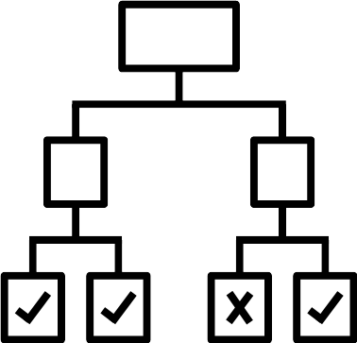
Data-based decision-making
What does an artificial intelligence need to learn?
Notes:
This presentation can be used to debrief the Quickdraw activity with the pupils.

Slide 2


What can artificial intelligence do?
Object
Class
Artificial intelligence assigns objects to a class. This is called classification.
Possible examples:
Assign an image/photo to a motif
Classify a video/song as recommended or not recommended (YouTube, TikTok)
Classify a foodstuff as recommended or not recommended
Notes:
What can an AI that has been trained using machine learning do? It can classify new objects (e.g. when we paint a new object). This means that a picture is assigned to a class (e.g. crayon, fan, etc.). This can only result in classes for which suitable examples with labels were known during the training process. So if training was not carried out with pictures of cars, the AI can also recognize small cars.
This is explored in this series of lessons using food as an example.

Slide 3
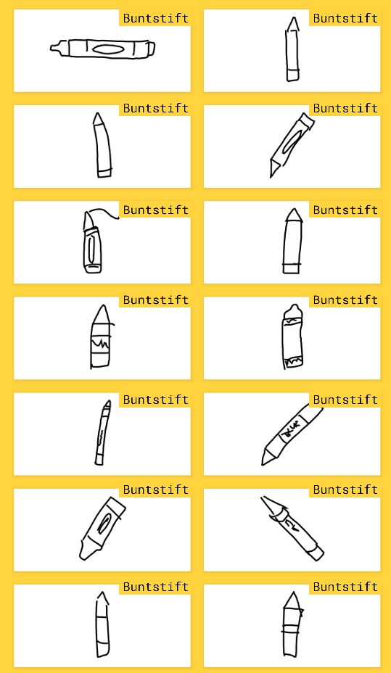
The task was to create a
Draw with colored pencil
Notes:
Here it can be discussed that Quickdraw only works because an AI has been trained using many sample images with suitable labels. However, it is not clear how such a training or machine learning process works!
Outlook for the following lessons: We will provide examples of food with the appropriate label. We then want to find out how machine learning works,

Slide 4
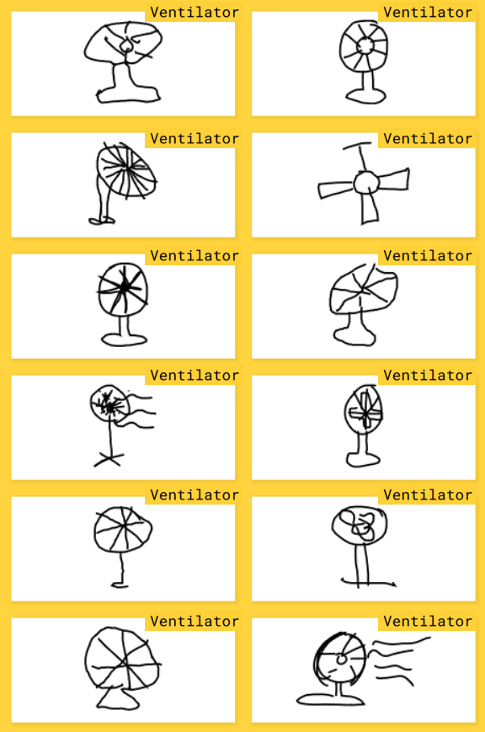

The task was to create a
Draw fan
Notes:
For machine learning, a collection of suitable examples with labels is required for each class of objects (e.g. fans) that are to be recognized. The objects must be digitally represented by certain features.

Slide 5
What does artificial intelligence need to learn?
Data with label
Training
How can such a
training work?
Many example objects, each assigned to a class
Notes:
raise the question: How can such a training process work?
Transition: We want to look at this in the next few lessons on the topic of food. We want to create an AI that helps us to classify food as "rather recommendable" or "rather not recommendable"

